Slide 1
Module V Transport layer
TCP & UDP

Slide 2
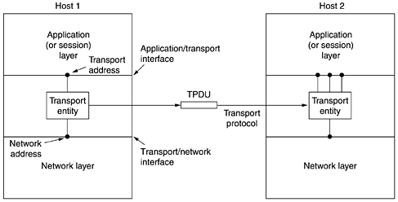
Introduction
heart of the whole protocol hierarchy
ultimate goal of the transport layer is to provide efficient, reliable, and cost-effective service to its users, normally processes in the application layer.
The hardware and/or software within the transport layer that does the work is called the transport entity.

Slide 3
Transport service
Two types of transport services:
connection-oriented transport service
connectionless transport service
Egs: client-server computing and streaming multimedia
Both are similar to Network layer services
But difference is
transport code runs entirely on the users' machines,
but the network layer mostly runs on the routers, which are operated by the carrier
Transport layer forms the major boundary between the service provider and service user of the reliable data transmission service

Slide 4
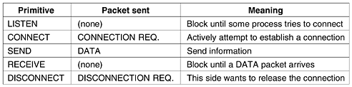
Transport Service Primitives
Transport Service Primitives
purpose of the transport layer
to provide a reliable service on top of an unreliable network
Fig: The primitives for a simple transport service

Slide 5
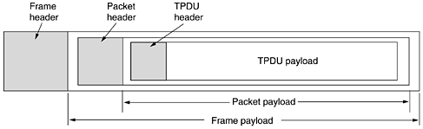
Transport Service Primitives
Fig: Nesting of TPDUs, packets, and frames

Slide 6
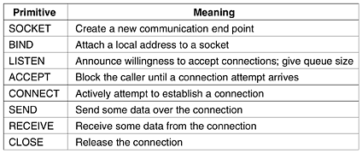
Transport Service Primitives
Fig: socket primitives used in Berkeley UNIX for TCP
widely used for Internet programming

Slide 7
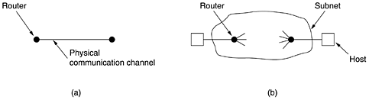
Elements of Transport Protocol
Fig: (a) Environment of the data link layer.
(b) Environment of the transport layer.

Slide 8
Elements of Transport Protocol
Similarities of transport layer with data link layer:
Both have to deal with error control, sequencing, and flow control
Differences:
Data link Layer | Transport Layer
each outgoing line uniquely specifies a particular router | explicit addressing of destinations is required
other end is always there | initial connection establishment is more complicated
existence of storage capacity in the subnet helps | existence of storage capacity in the subnet needs special protocols
Buffering and flow control are simple | Buffering and flow control are complicated for dynamic connections

Slide 9
Addressing
When an application process wishes to set up a connection to a remote application process, it must specify which one to connect to.
Method normally used is
to define transport addresses to which processes can listen for connection requests.
In the Internet, these end points are called ports.
We will use the generic term TSAP (Transport Service Access Point)

Slide 10

Internet Transport Protocols: UDP
UDP (User Datagram Protocol)
connectionless transport protocol
UDP is basically just IP with a short header added
provides a way for applications to send encapsulated IP datagrams and send them without having to establish a connection
UDP transmits segments consisting of an 8-byte header followed by the payload
Fig: The UDP header

Slide 11
Internet Transport Protocols: UDP
Two ports are used to identify the end points within the source and destination machines.
When a UDP packet arrives, its payload is handed to the process attached to the destination port.
This attachment occurs when BIND primitive is used
Without the port fields, the transport layer would not know what to do with the packet.
With ports, it delivers segments correctly
source port is primarily needed when a reply must be sent back to the source
UDP length field includes the 8-byte header and the data
UDP checksum is optional and stored as 0 if not computed

Slide 12
Internet Transport Protocols: UDP
UDP does not do
flow control,
error control, or
retransmission upon receipt of a bad segment
UDP does
provide an interface to the IP protocol with the added feature of demultiplexing multiple processes using the ports

Slide 13
Internet Transport Protocols: UDP
Applications:
client-server
client sends a short request to the server and expects a short reply back
Eg: DNS, RPC, RTP
DNS
program that needs to look up the IP address of some host name can send a UDP packet containing the host name to a DNS server.
The server replies with a UDP packet containing the host's IP address.
No setup is needed in advance and no release is needed afterward.

Slide 14
Internet Transport Protocols: UDP
Remote Procedure Call (RPC)
When a process on machine 1 calls a procedure on machine 2, the calling process on 1 is suspended and execution of the called procedure takes place on 2.
Information can be transported from the caller to the callee in the parameters and can come back in the procedure result.
No message passing is visible to the programmer.
This technique is known as RPC (Remote Procedure Call)

Slide 15
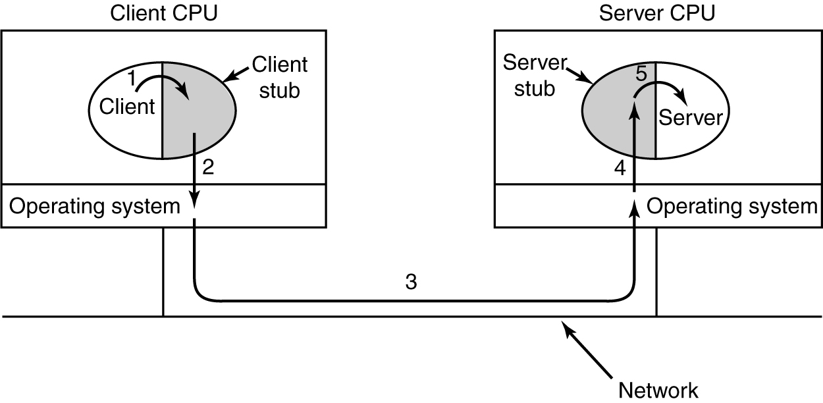
Internet Transport Protocols: UDP
Remote Procedure Call
Fig: Steps in making a remote procedure call

Slide 16
Internet Transport Protocols: UDP
Steps in making an RPC
client calling the client stub.
This call is a local procedure call, with the parameters pushed onto the stack in the normal way.
client stub packing the parameters into a message and making a system call to send the message.
Packing the parameters is called marshaling.
kernel sending the message from the client machine to the server machine.
kernel passing the incoming packet to the server stub.
server stub calling the server procedure with the unmarshaled parameters.
The reply traces the same path in the other direction.

Slide 17
Internet Transport Protocols: UDP
Problems faced by RPC
passing pointers is impossible because the client and server are in different address spaces.
Trick to overcome this
standard calling sequence of call-by-reference has been replaced by copy-restore.
this trick does not always work, for example, if the pointer points to a graph or other complex data structure
computes the inner product of two vectors (arrays), without specifying how large either one is
marshalling the parameters has no way of determining how large they are.

Slide 18
Internet Transport Protocols: UDP
not always possible to deduce the types of the parameters
example is printf,
which may have any number of parameters with a mixture of integers, shorts, longs, characters, strings, floating-point numbers of various lengths, and other types.
Trying to call printf as a remote procedure would be practically impossible
use of global variables
code will fail because the global variables are no longer shared
Still UDP is commonly used for RPC

Slide 19
Internet Transport Protocols: UDP
UDP is widely used in another area called real-time multimedia applications
Egs:
Internet radio,
Internet telephony,
music-on-demand,
videoconferencing,
video-on-demand
generic real-time transport protocol for multiple applications called RTP (Real-time Transport Protocol) was born
basic function of RTP is to multiplex several real-time data streams onto a single stream of UDP packets

Slide 20
Internet Transport Protocols: UDP
Working of RTP:
multimedia application consists of multiple audio, video, text, and possibly other streams.
These are fed into the RTP library, which is in user space along with the application.
This library then multiplexes the streams and encodes them in RTP packets, which it then stuffs into a socket.
At the other end of the socket (in the operating system kernel), UDP packets are generated and embedded in IP packets.
If the computer is on an Ethernet, the IP packets are then put in Ethernet frames for transmission.
it is a transport protocol that is implemented in the application layer

Slide 21
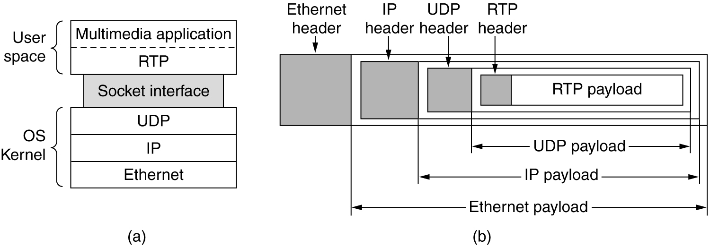
Internet Transport Protocols: UDP
Fig: (a) The position of RTP in the protocol stack.
(b) Packet nesting.

Slide 22
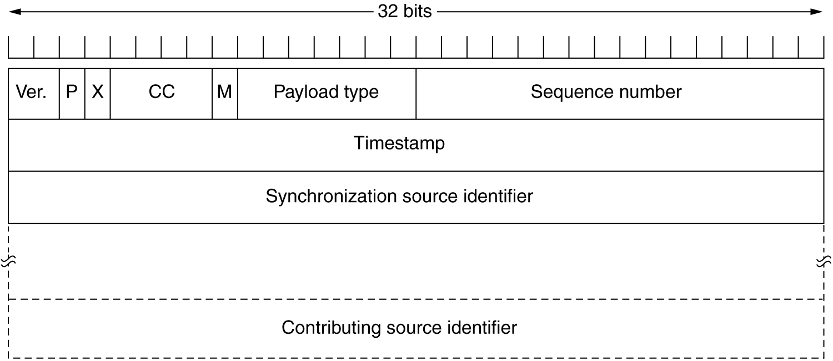
Internet Transport Protocols: UDP
Fig: RTP header

Slide 23
Internet Transport Protocols: UDP
Version field
already at 2
P bit
indicates that the packet has been padded to a multiple of 4 bytes.
last padding byte tells how many bytes were added
X bit
indicates that an extension header is present.
The format and meaning of the extension header are not defined
CC field
tells how many contributing sources are present, from 0 to 15

Slide 24
Internet Transport Protocols: UDP
M bit
an application-specific marker bit.
It can be used to mark
start of a video frame,
start of a word in an audio channel,
Payload type field
tells which encoding algorithm has been used
(e.g., uncompressed 8-bit audio, MP3, etc.).
Since every packet carries this field, the encoding can change during transmission.
Sequence number
a counter that is incremented on each RTP packet sent.
It is used to detect lost packets.

Slide 25
Internet Transport Protocols: UDP
Timestamp
produced by the stream's source to note when the first sample in the packet was made.
This value can help reduce jitter at the receiver.
Synchronization source identifier
tells which stream the packet belongs to.
It is the method used to multiplex and demultiplex multiple data streams onto a single stream of UDP packets.
Contributing source identifiers,
used when mixers are present in the studio.
In that case, the mixer is the synchronizing source, and the streams being mixed are listed here.

Slide 26
Internet Transport Protocols: UDP
RTP has a little sister protocol called RTCP (Realtime Transport Control Protocol).
It handles feedback, synchronization, and the user interface but does not transport any data.
feedback on delay, jitter, bandwidth, congestion, and other network properties to the sources
used by the encoding process
to increase the data rate (and give better quality) when the network is functioning well and
to cut back the data rate when there is trouble in the network.

Slide 27
Internet Transport Protocols: UDP
RTCP also handles interstream synchronization.
The problem is that different streams may use different clocks, with different granularities and different drift rates.
RTCP can be used to keep them in sync
RTCP provides a way for naming the various sources (e.g., in ASCII text).
This information can be displayed on the receiver's screen to indicate who is talking at the moment.

Slide 28
Internet Transport Protocols: TCP
for most Internet applications, reliable, sequenced delivery is needed
UDP cannot provide this, so another protocol is required.
It is called TCP (Transmission Control Protocol)
It is the main workhorse of the Internet.
TCP was designed to
provide a reliable end-to-end byte stream over an unreliable internetwork
dynamically adapt to properties (different topologies, bandwidths, delays, packet sizes, etc) of the internetwork
be robust in the face of many kinds of failures

Slide 29
Internet Transport Protocols: TCP
Each machine supporting TCP has a TCP transport entity, either a library procedure, a user process, or part of the kernel.
A TCP entity accepts user data streams from local processes, breaks them up into pieces not exceeding 64 KB and sends each piece as a separate IP datagram.
When datagrams containing TCP data arrive at a machine, they are given to the TCP entity, which reconstructs the original byte streams.

Slide 30
Internet Transport Protocols: TCP
TCP Service Model
TCP service is obtained by both the sender and receiver creating end points called sockets
Each socket has a socket number (address) consisting of the IP address of the host and a 16-bit number local to that host, called a port.
A port is the TCP name for a TSAP.
For TCP service to be obtained, a connection must be explicitly established between a socket on the sending machine and a socket on the receiving machine.
A socket may be used for multiple connections at the same time.
Connections are identified by the socket identifiers at both ends, that is, (socket1, socket2)

Slide 31
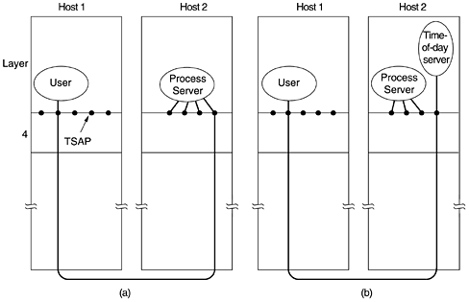
Internet Transport Protocols: TCP

Slide 32
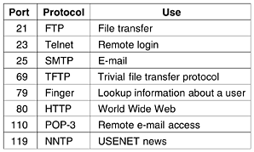
Internet Transport Protocols: TCP
Port numbers below 1024 are called well-known ports and are reserved for standard services.
Fig: Some assigned ports.

Slide 33
Internet Transport Protocols: TCP
All TCP connections are full duplex and point-to-point.
Full duplex
traffic can go in both directions at the same time.
Point-to-point
each connection has exactly two end points.
TCP does not support multicasting or broadcasting.
TCP connection is a byte stream, not a message stream.
Message boundaries are not preserved end to end.
For example, if the sending process writes four 512-byte to a TCP stream, these data may be delivered to the receiving process as four 512-byte chunks, two 1024-byte chunks, one 2048-byte chunk
There is no way for the receiver to detect the unit(s) in which the data were written

Slide 34
Internet Transport Protocols: TCP
To force data out immediately, applications can use the PUSH flag, which tells TCP not to delay the transmission
URGENT flag causes TCP to stop accumulating data and transmit everything it has for that connection immediately
The end of the urgent data is marked so the application knows when it is over.
TCP Protocol
key feature of TCP
every byte on a TCP connection has its own 32-bit sequence number
sending and receiving TCP entities exchange data in the form of segments

Slide 35
Internet Transport Protocols: TCP
TCP segment consists of a fixed 20-byte header (plus an optional part) followed by zero or more data bytes.
The TCP software decides how big segments should be.
can accumulate data from several writes into one segment or
can split data from one write over multiple segments.
Two limits restrict the segment size.
each segment including the TCP header, must fit in the 65,515-byte IP payload.
each network has a Maximum Transfer Unit, or MTU and each segment must fit in the MTU.
basic protocol used by TCP entities is the sliding window protocol

Slide 36
Internet Transport Protocols: TCP
TCP Segment Header
Every segment begins with a fixed-format, 20-byte header.
The fixed header may be followed by header options.
After the options, if any, up to 65,535 - 20 - 20 = 65,495 data bytes may follow,
where the first 20 refer to the IP header and
the second to the TCP header.
Segments without any data are legal and are commonly used for acknowledgements and control messages.

Slide 37
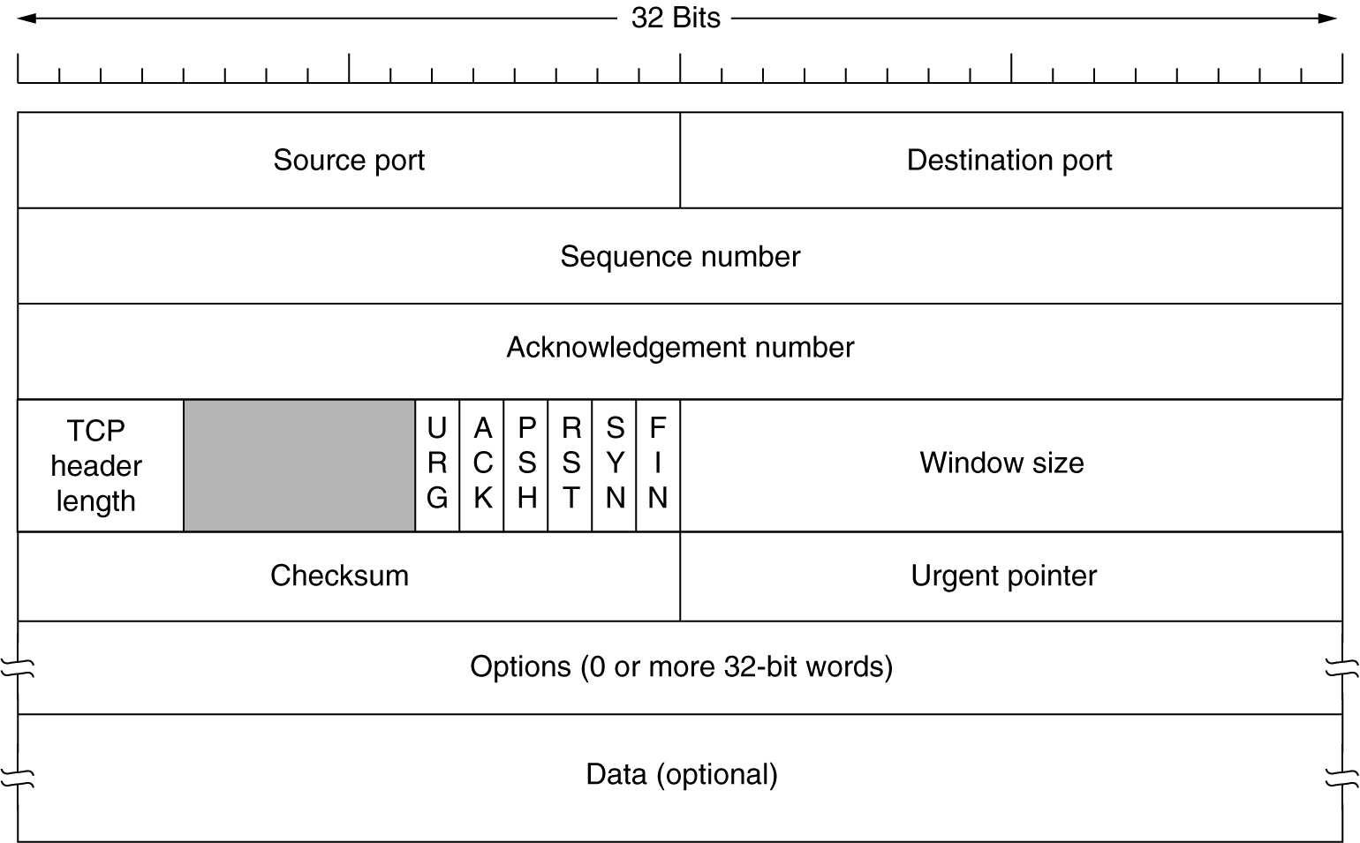
Internet Transport Protocols: TCP
Fig: TCP header

Slide 38
Internet Transport Protocols: TCP
Source port and Destination port fields
identify the local end points of the connection.
A port plus its host's IP address forms a 48-bit unique end point.
The source and destination end points together identify the connection
Sequence number and Acknowledgement number fields
perform their usual functions
Ack no. specifies the next byte expected, not the last byte correctly received.
Both are 32 bits long because every byte of data is numbered in a TCP stream

Slide 39
Internet Transport Protocols: TCP
TCP header length
tells how many 32-bit words are contained in the TCP header.
This information is needed because the Options field is of variable length
Technically, this field really indicates the start of the data within the segment, measured in 32-bit words
six 1-bit flags
URG bit
set to 1 if the Urgent pointer is in use.
The Urgent pointer is used to indicate a byte offset from the current sequence number at which urgent data are to be found.

Slide 40
Internet Transport Protocols: TCP
ACK bit
set to 1 to indicate that the Acknowledgement number is valid.
If ACK is 0, the segment does not contain an acknowledgement so the Acknowledgement number field is ignored.
PSH bit
indicates PUSHed data.
The receiver is hereby kindly requested to deliver the data to the application upon arrival and not buffer it until a full buffer has been received

Slide 41
Internet Transport Protocols: TCP
RST bit
used to reset a connection that has become confused due to a host crash or some other reason.
also used to reject an invalid segment or refuse an attempt to open a connection.
SYN bit
used to establish connections.
The CONNECTION REQUEST has SYN = 1 and ACK = 0 to indicate that the piggyback acknowledgement field is not in use.
The CONNECTION ACCEPTED reply does bear an acknowledgement, so it has SYN = 1 and ACK = 1.

Slide 42
Internet Transport Protocols: TCP
FIN bit
used to release a connection.
It specifies that the sender has no more data to transmit.
Window size field
tells how many bytes may be sent starting at the byte acknowledged.
Flow control in TCP is handled using a variable-sized sliding window which gives additional flexibility
A Window size field of 0 is legal
It says that the bytes up to and including Acknowledgement number - 1 have been received,
but that the receiver is currently badly in need of a rest and would like no more data.

Slide 43
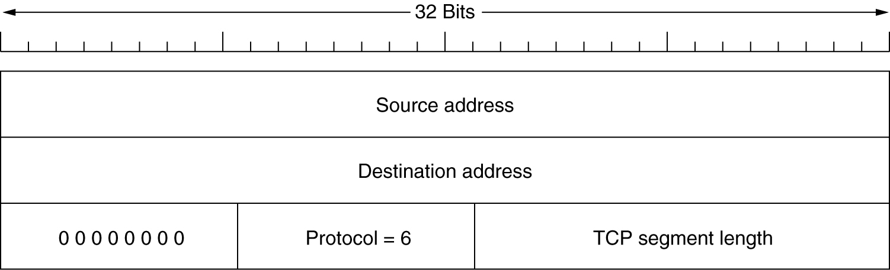
Internet Transport Protocols: TCP
The receiver can later grant permission to send by transmitting a segment with the same Acknowledgement number and a nonzero Window size field.
Checksum field
provided for extra reliability. It checksums the header, the data, and the conceptual pseudoheader shown in Fig.
Fig: pseudoheader included in the TCP checksum

Slide 44
Internet Transport Protocols: TCP
When performing this computation,
TCP Checksum field is set to zero and
data field is padded out with an additional zero byte if its length is an odd number.
checksum algorithm is
simply to add up all the 16-bit words in one's complement and then
to take the one's complement of the sum.
As a consequence, when the receiver performs the calculation on the entire segment, including the Checksum field, the result should be 0.

Slide 45
Internet Transport Protocols: TCP
Options field
provides a way to add extra facilities not covered by the regular header.
most important option is the one that allows each host to specify the maximum TCP payload it is willing to accept.
During connection setup, each side can announce its maximum and see its partner's.
If a host does not use this option, it defaults to a 536-byte payload.
All Internet hosts are required to accept TCP segments of 536 + 20 = 556 bytes.

Slide 46
Internet Transport Protocols: TCP
Window scale option was proposed, allowing the sender and receiver to negotiate a window scale factor.
This number allows both sides to shift the Window size field up to 14 bits to the left, thus allowing windows of up to 2³⁰ bytes.
Most TCP implementations now support this option
Another option proposed and now widely implemented is the use of the selective repeat instead of go back n protocol.
NAKs are introduced to allow the receiver to ask for a specific segment.
After it gets these, it can acknowledge all the buffered data, thus reducing the amount of data retransmitted.

Slide 47
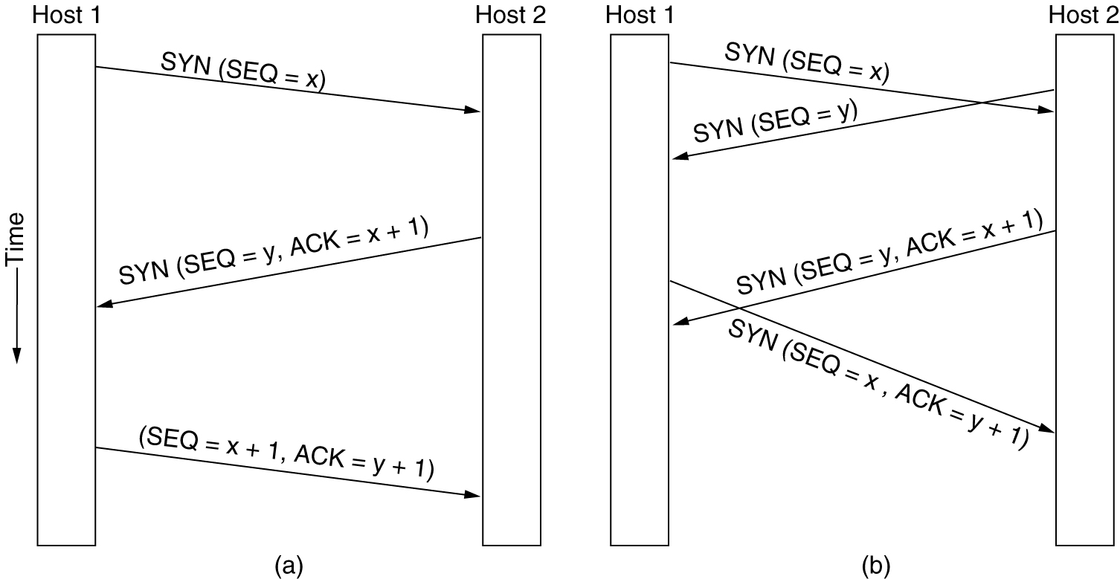
Internet Transport Protocols: TCP
TCP Connection Establishment
Connections are established in TCP by means of the three-way handshake
Fig: (a) TCP connection establishment in the normal case.
(b) Call collision.

Slide 48
Internet Transport Protocols: TCP
TCP Connection Release
To release a connection, either party can send a TCP segment with the FIN bit set, which means that it has no more data to transmit.
When the FIN is acknowledged, that direction is shut down for new data.
When both directions have been shut down, the connection is released.
Normally, four TCP segments are needed to release a connection, one FIN and one ACK for each direction.
However, it is possible for the first ACK and the second FIN to be contained in the same segment, reducing the total count to three.

Slide 49
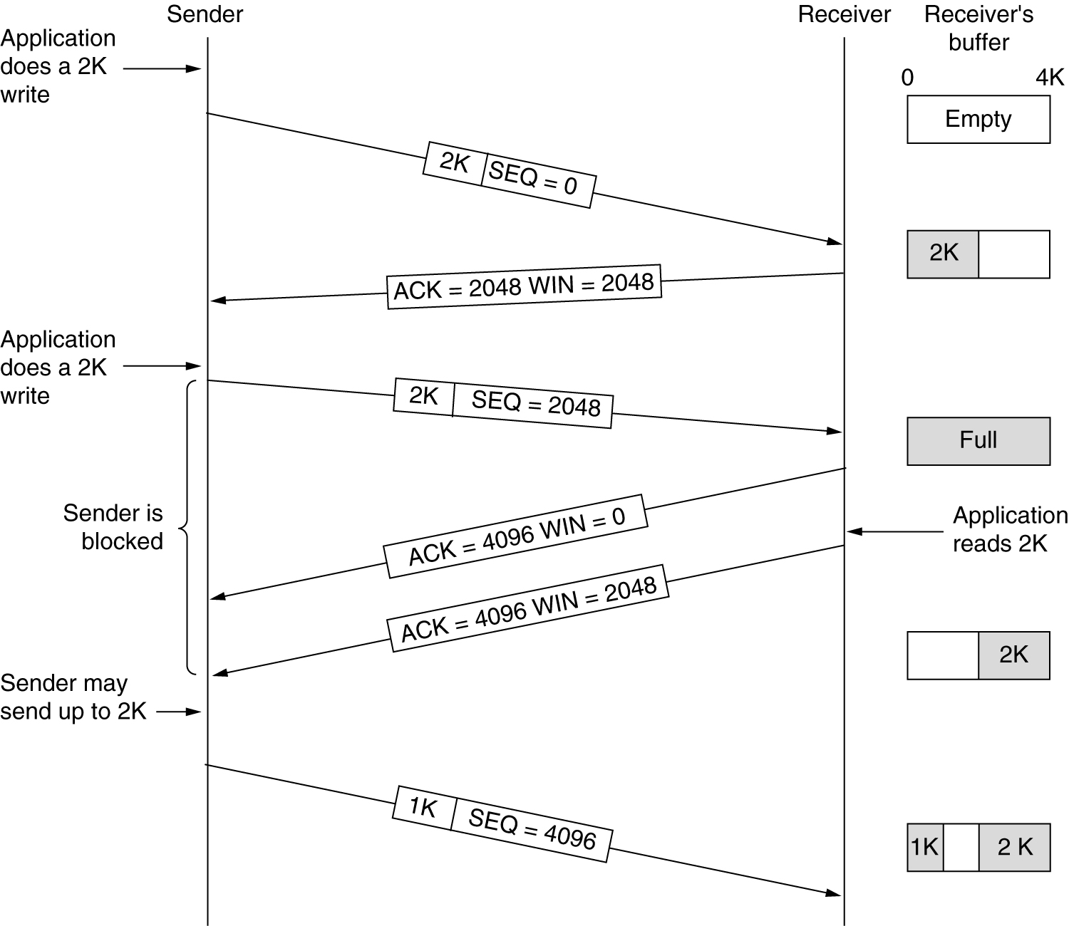
Internet Transport Protocols: TCP
TCP Transmission Policy
Fig: Window management in TCP.

Slide 50
Internet Transport Protocols: TCP
Nagle's algorithm
when data come into the sender one byte at a time, just send the first byte and buffer all the rest until the outstanding byte is acknowledged.
Then send all the buffered characters in one TCP segment and start buffering again until they are all acknowledged.
If the user is typing quickly and the network is slow, a substantial number of characters may go in each segment, greatly reducing the bandwidth used.
The algorithm additionally allows a new packet to be sent if enough data have trickled in to fill half the window or a maximum segment
Nagle's algorithm is widely used by TCP implementations

Slide 51
Internet Transport Protocols: TCP
Silly window syndrome
problem that can degrade TCP performance
This problem occurs when data are passed to the sending TCP entity in large blocks, but an interactive application on the receiving side reads data 1 byte at a time.
Initially, the TCP buffer on the receiving side is full and the sender knows this (i.e., has a window of size 0).
Then the interactive application reads one character from the TCP stream.
This action makes the receiving TCP to send a window update to the sender saying it to send 1 byte.
The sender sends 1 byte.
The buffer is now full, so the receiver acknowledges the 1-byte segment but sets the window to 0.
This behavior can go on forever.

Slide 52
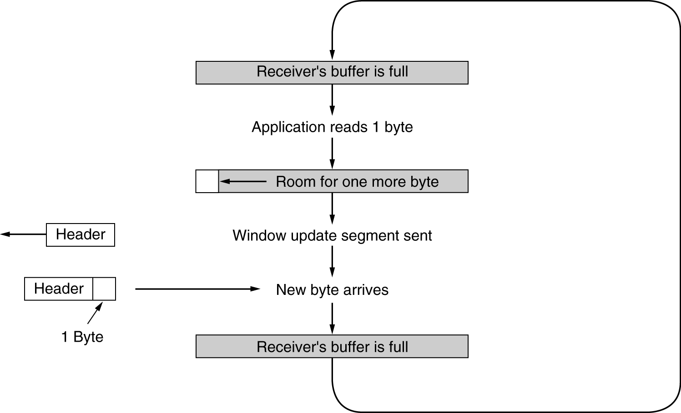
Internet Transport Protocols: TCP
Silly window syndrome

Slide 53
Internet Transport Protocols: TCP
Clark's solution is to prevent the receiver from sending a window update for 1 byte.
the receiver must wait until it can handle the maximum segment size it advertised when the connection was established or until its buffer is half empty
Nagle's algorithm and Clark's solution to the silly window syndrome are complementary.
Nagle was trying to solve the problem caused by the sending application delivering data to TCP a byte at a time.
Clark was trying to solve the problem of the receiving application taking the data up from TCP a byte at a time.
Both solutions are valid and can work together.
Goal is for the sender not to send small segments and the receiver not to ask for them.

Slide 54
Internet Transport Protocols: TCP
TCP Congestion Control
When the load offered to any network is more than it can handle, congestion builds up.
each sender maintains two windows:
the window the receiver has granted and
a second window, the congestion window
Each reflects the number of bytes the sender may transmit.
The number of bytes that may be sent is the minimum of the two windows.

Slide 55
Internet Transport Protocols: TCP
When a connection is established, the sender initializes the congestion window to the size of the maximum segment in use on the connection.
It then sends one maximum segment.
If this segment is acknowledged before the timer goes off, it sends two segments.
As each of these segments is acknowledged, the congestion window is increased by one maximum segment size.
When the congestion window is n segments, if all n are acknowledged on time, the congestion window is increased by the byte count corresponding to n segments.
In effect, each burst acknowledged doubles the congestion window.

Slide 56
Internet Transport Protocols: TCP
congestion window keeps growing exponentially until either a timeout occurs or the receiver's window is reached.
This algorithm is called slow start, but it is not slow at all
It is exponential.
All TCP implementations are required to support it.
Internet congestion control algorithm:
It uses a third parameter, the threshold, initially 64 KB, in addition to the receiver and congestion windows.
When a timeout occurs, the threshold is set to half of the current congestion window, and the congestion window is reset to one maximum segment.
Slow start is then used to determine what the network can handle, except that exponential growth stops when the threshold is hit.

Slide 57
Internet Transport Protocols: TCP
TCP Timer Management
TCP uses multiple timers
retransmission timer
When a segment is sent, a retransmission timer is started.
If the segment is acknowledged before the timer expires, the timer is stopped.
If, on the other hand, the timer goes off before the acknowledgement comes in, the segment is retransmitted and the timer started again
RTT - Round Trip Time
D - Standard Deviation

Slide 58
Internet Transport Protocols: TCP
One problem that occurs with the dynamic estimation of RTT is what to do when a segment times out and is sent again.
When the acknowledgement comes in, it is unclear whether the acknowledgement refers to the first transmission or a later one.
Solution is called Karn's algorithm.
do not update RTT on any segments that have been retransmitted.
Instead, the timeout is doubled on each failure until the segments get through the first time.
Most TCP implementations use it

Slide 59
Internet Transport Protocols: TCP
persistence timer:
designed to prevent the following deadlock.
The receiver sends an acknowledgement with a window size of 0, telling the sender to wait.
Later, the receiver updates the window, but the packet with the update is lost.
Now both the sender and the receiver are waiting for each other to do something.
When the persistence timer goes off, the sender transmits a probe to the receiver.
The response to the probe gives the window size.
If it is still zero, the persistence timer is set again and the cycle repeats.
If it is nonzero, data can now be sent.

Slide 60
Internet Transport Protocols: TCP
keepalive timer:
When a connection has been idle for a long time, the keepalive timer may go off to cause one side to check whether the other side is still there.
If it fails to respond, the connection is terminated.
This feature is controversial because it adds overhead and may terminate an otherwise healthy connection due to a temporary network partition.
Timer used in the TIMED WAIT state while closing
It runs for twice the maximum packet lifetime to make sure that when a connection is closed, all packets created by it have died off.

Slide 61
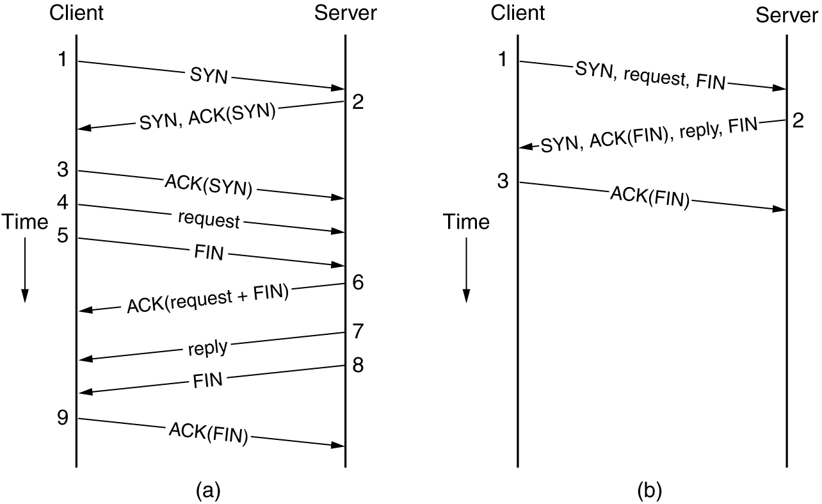
Internet Transport Protocols: TCP
Transactional TCP (T/TCP) handles client-server interactions with a reduced number of packets
Fig: (a) RPC using normal TCP. (b) RPC using T/TCP.

